Slide 1

Faculty of engineering – Helwan University – Credit hours section-major of electrical systems protection
Graduation Project (2) for year 2018-2019
Wide Area Measurement and Protection
Submitted by :
1- Hazem Khaled Mossad
2-Fathy Wahed
3- Ahmed mohamed ibrahem
4- Zeyad Khaled
-Omar Samir saber
-Ahmed Yasser Torky
-Mohamed Ayman El-Rasheed
8- Mohamed Hosni
-Ahmed Moawad
-Eslam Ahmed
-Abdallah Abdelhay
-Beshoy Gerges
-Moahmed Yehia
- Omar Fatouh
Supervised by:
-Prof.Dr.Eng/Masoad Al-shahat
-Prof.Dr.Eng/Saeed El-Masri
3-Prof.Dr.Eng/Mohy Bahag

Slide 2
ACKNOWLEDGEMENT
First of all, we are deeply grateful to the Almighty Allah for his kindness and blessings. We sincerely thank our Professors for their support both academically and emotionally. We would like to thank our supervisors :
Prof. Dr. Masood elShahat.
Prof.Dr. Saeed elMasry .
Prof. Dr. Mohy.
for giving us the opportunity to work on such project. In addition to their patience, we appreciate their encouragement, guidance, and support throughout the whole project.

Slide 3
ABSTRACT
In the present modern era, the demand of electrical energy has greatly increased. The demand of electric supply has been increased drastically which requires a very costly kind of equipments and huge in size with a huge distance between each of them that requires an agile way of communication for taking the right action required for the fault
Our Project is based on simulating a part of the grid and communicating the data of the system to a PDC using wifi and GPS to give an accurate real time data.
In order to achieve this we analyzed the system before hand and simulated the several faults and failures in order to have an accurate data in implementation along with integrating the protection with the communication part in the project.

Slide 4
LIST OF CONTENTS
LIST OF ACRONYMS
Chapter 1 : Introduction
1.1. MOTIVATION FOR THE WORK.
1.2. BASIC COMPONENTS IN WIDE AREA.
Chapter 2 : PMU
2.1. Introduction
2.2. PMU ARCHITECTURE.
2.3. DISTRIBUTED PMU.
Chapter 3 : PDC.
3.1. PDC Introduction and ARCHITECTURE.
Chapter 4 : IEC 61850 Standard.
4.1 . Introduction to IEC 61850 Standard.
4.2 . Standard Communication Services and Bus
Architecture.
4.3 . IEC TR 61850-90-5 Guidelines for Reporting
Synchrophasors
4.4 . IEC 61850 Object Model for WAMPAC Applications Using Synchrophasors.
4.5 . Modes of Synchrophasor Communication.
Chapter 5 : WAMPCS APPLICATION.
4.1 . Introduction
4.2. different modules
4.3. main project system instruments
CONCLUSION
References
.

Slide 5
LIST OF ACRONYMS
RF : radio frequency
GPS : global positioning system
WAMPCS : wide area measurement and control system
IED : intelligent electronic devices
MCU : micro controller unit
UART : universal asynchrouns recevier and transmitter
ASK : Amplitude shift keying
LCD : liquid crystal display
MU : Merging unit.
GOOSE : Generic Object Oriented Substation Events.
UDP : User Data Gram.
TCP : Transmission Control Protocol.

Slide 6

CHAPTER 1 : INTRODUCTION

Slide 7
1.2.BASIC COMPONENTS IN WIDE AREA.
1 – Synchronized Phasor Measurement System (SPMS).
The Synchronized Phasor Measurement System (SPMS) was firstly developed and introduced into the power system in mid-1980s. These systems have the ability of measuring currents and voltages, and calculating the angle between them. This ability has been made possible by the availability of Global Positioning System (GPS); on the one hand, and the sampled data processing techniques; on the other hand. In order to synchronize measured angles, SPMS uses time received from GPS as its sampling clock. In addition to measuring angles of voltages and currents, these systems can also measure local frequency and rates of frequency changes, and may be customized to measure harmonics, negative and zero sequence quantities (Phadke & Thorp, 2008). A SPMS consists of three main parts: Phasor Measurement Unit (PMU), Phasor Data Concentrator (PDC), and communication system. PMUs are normally installed at remote sites. They calculate phasors of voltages and currents and stamp measured phasors with the time received from GPS. A PDC gathers data from several PMUs, rejects bad data, and aligns the time stamps. Communication system of SPMS is responsible for data delivery between PMUs and a PDC or multiple PDCs (Phadke & Thorp, 2008). Fig. 3 shows the hierarchy of SPMS. The next three sub-sections are going to describe each part of SPMS, separately.

Slide 8
2 – Phasor Measurement Unit (PMU).
The Phasor Measurement Unit (PMU) is a microprocessor based device that uses the ability of digital signal processors in order to measure 50/60Hz AC waveforms (voltages and currents) at a typical rate of 48 samples per cycle (2400/2880 samples per second).
To do this, first, the analog AC waveforms are synchronously sampled by an A/D converter for each phase. In order to provide synchronous clock for the entire system, the time from GPS satellites are used as input for a phase-lock oscillator and thereby, waveforms of the entire system are sampled with 1 microsecond accuracy. In the next step, PMU uses digital signal processing techniques to calculate the voltage and current phasors. Also, line frequencies can be calculated by PMU at each site. By using this technique, a high degree of resolution and accuracy will be achieved. The measured phasors are tagged by GPS time stamps and are transmitted to a PDC at the rates 30-60 samples per second (EPG & CERTS, 2006). Phasor data is formed in COMTRADE format (Phadke & Thorp, 2008). A study of RTU tasks in SCADA system indicates that PMU and RTU have almost the same tasks in the SPMS and SCADA systems.

Slide 9
3 – Phasor Data Concentrator (PDC).
The main functions of a PDC are: to gather data from several PMUs, to reject bad data, to align the time stamps, and to create a coherent record of simultaneously recorded data. As a consequence, a snap-shot of phasors of the measured area can be obtained (Phadke & Thorp, 2008). In some cases, a central PDC may concentrate the area data received from other PDCs and may provide phasors of the entire system. A study of MTU tasks in a SCADA system indicates that the tasks and functions of PDC in SPMS systems are almost the same as those in SCADA systems.
4 – Communication infrastructure of WAMS.
The communication system of WAMS is responsible for data delivery from data resources to the control center(s) and from control center(s) to the system actuators. Indeed, the communication network of WAMS is similar to the neural network of humans. As in case of failure or mal-functioning of neural network paralyzed may happen, failure of communication network may cause huge problems in system operation and control, especially in operation of WAMS applications. Consequently, especial attention should be paid to communication infrastructure, which is as important as electrical infrastructure itself. These two infrastructures (communication and electrical) have become increasingly interdependent so that in the case of failure for each of them, another one may also become out of service (Shahidehpour & Wang, 2003; Lukszo et al., 2010). New communication systems are designed based on open system interconnection (OSI) layer model. In this

Slide 10
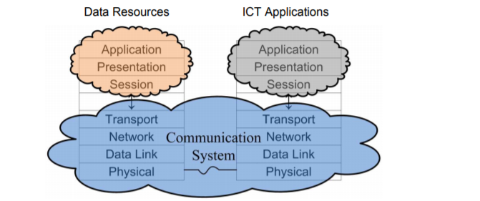
architecture, upper layers relay data, assuming that the lower layers work perfectly. In fact, this model is an effective architecture for explanation, designing, implementation, standardization and use of communications networks. The OSI reference model consists of seven layers: physical, data link, network, transport, session, presentation, and application (Shahraeini et al., 2010). In wide area measurement systems, data resources and WAMS applications normally work at the upper layers of network models. Fig. 1 shows the map between OSI layers and three major blocks of WAMS . data resources, WAMS applications and communication system (Shahraeini et al., 2010).
Fig. 1.

Slide 11
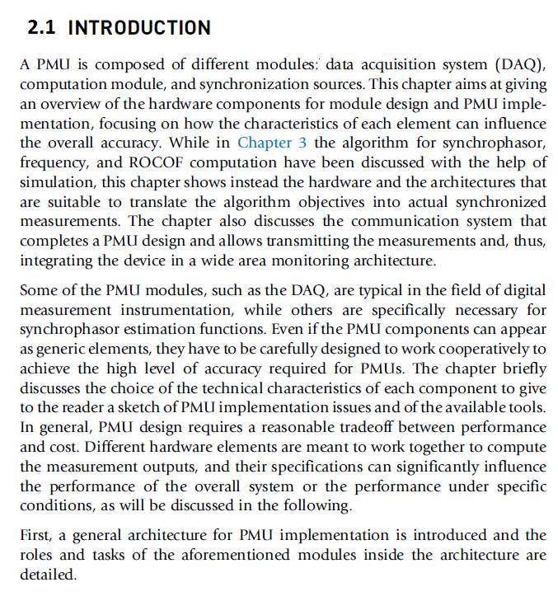
CHAPTER 2 : PMU

Slide 12
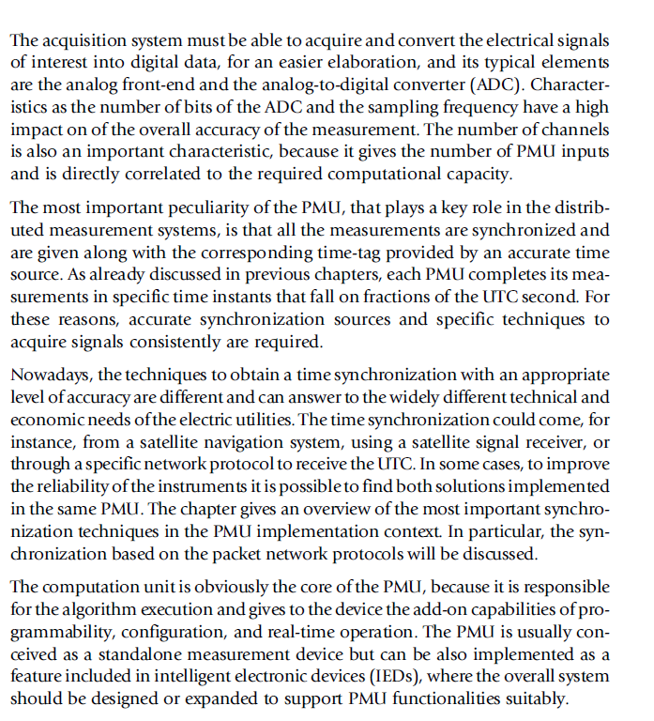

Slide 13
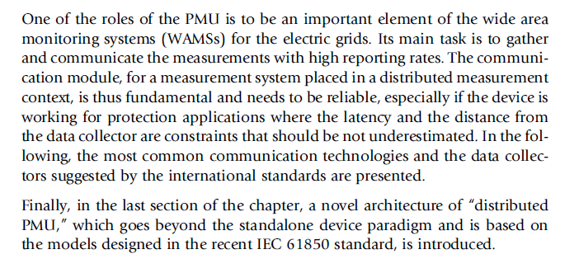

Slide 14
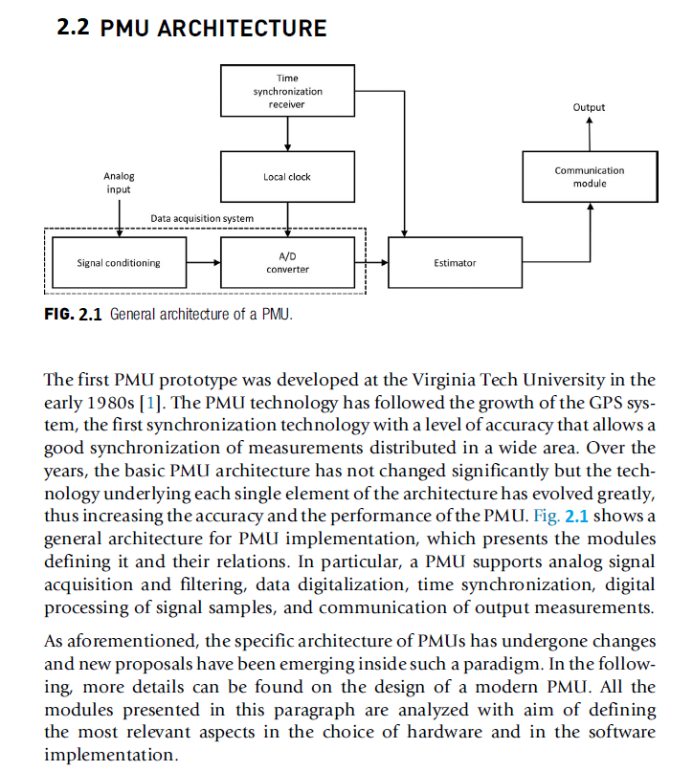

Slide 15
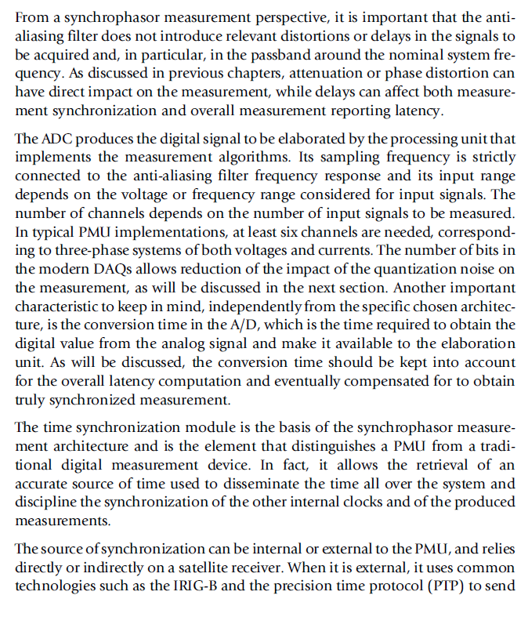

Slide 16
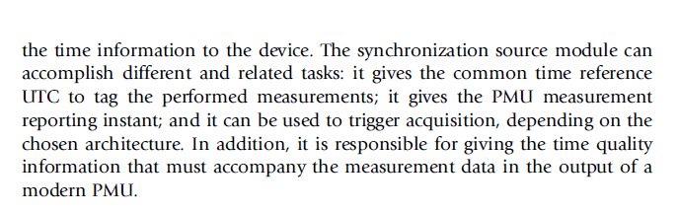

Slide 17
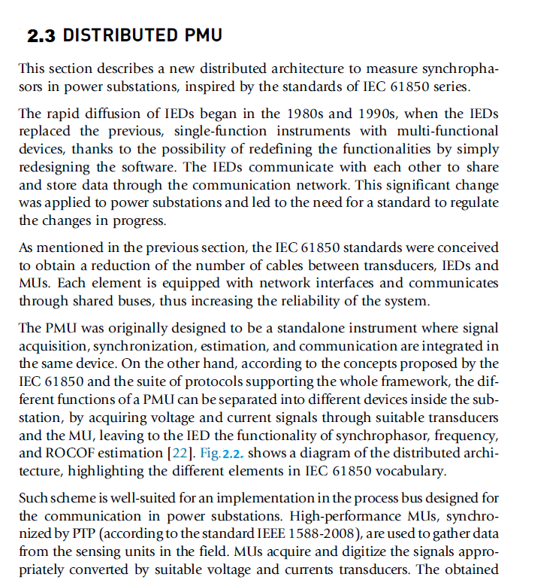

Slide 18
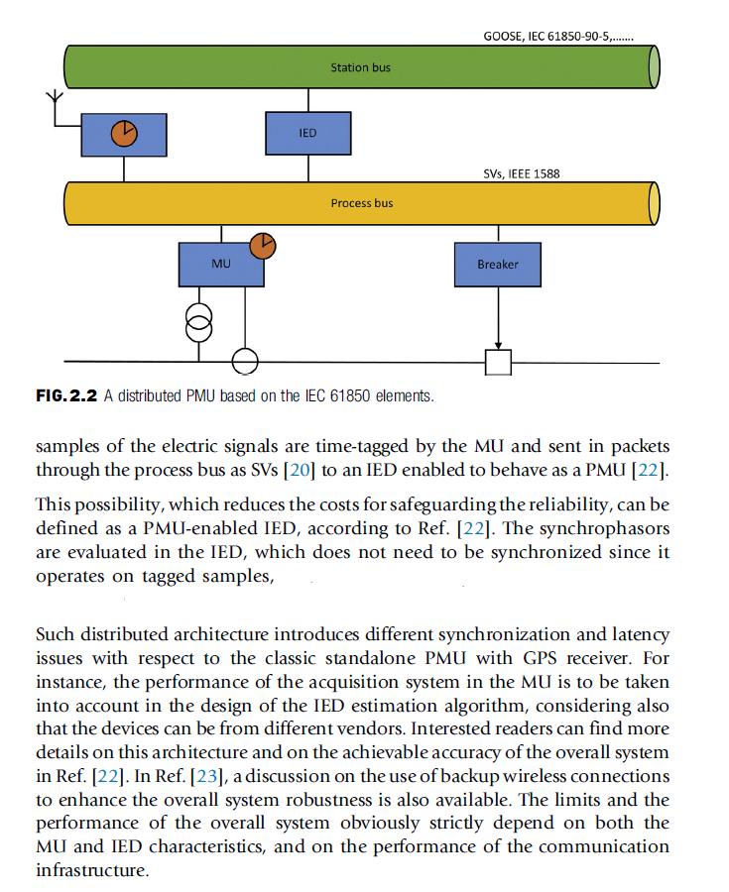

Slide 19
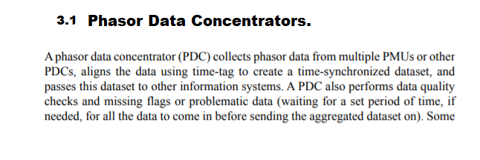
CHAPTER 3 : PDC

Slide 20
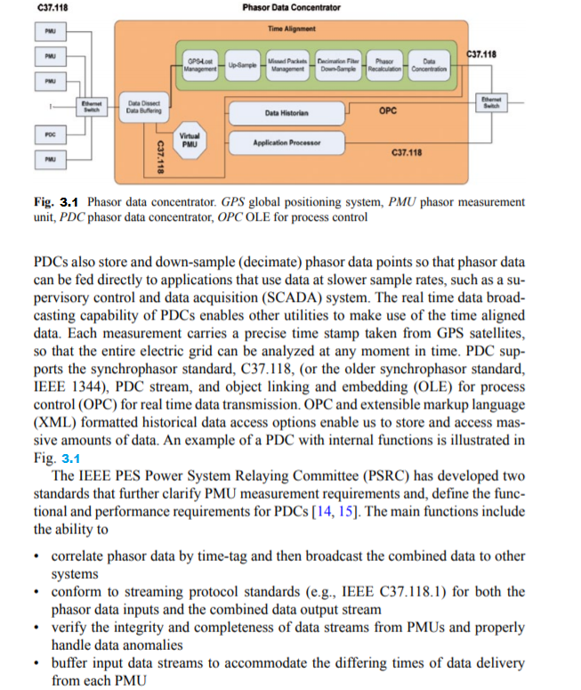

Slide 21
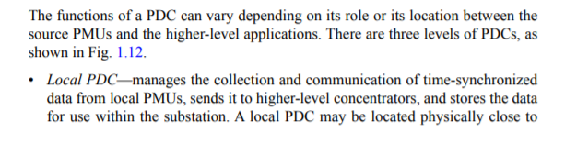
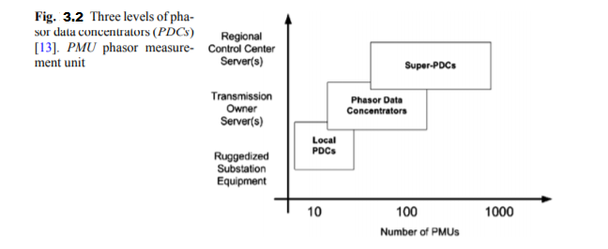

Slide 22
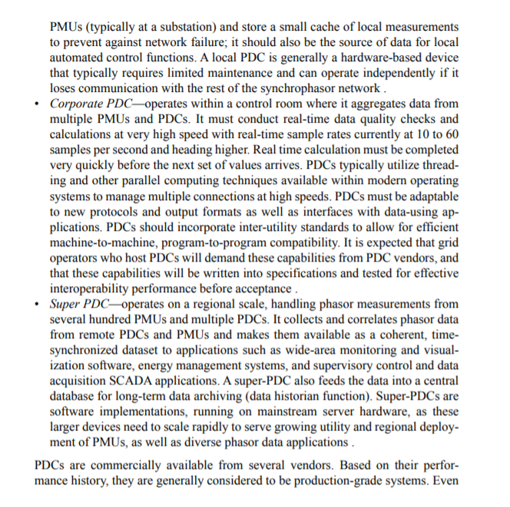

Slide 23
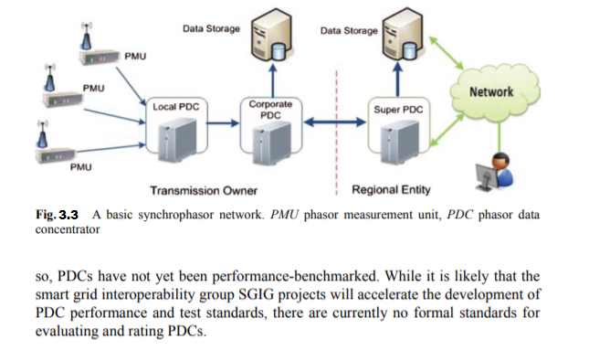

Slide 24
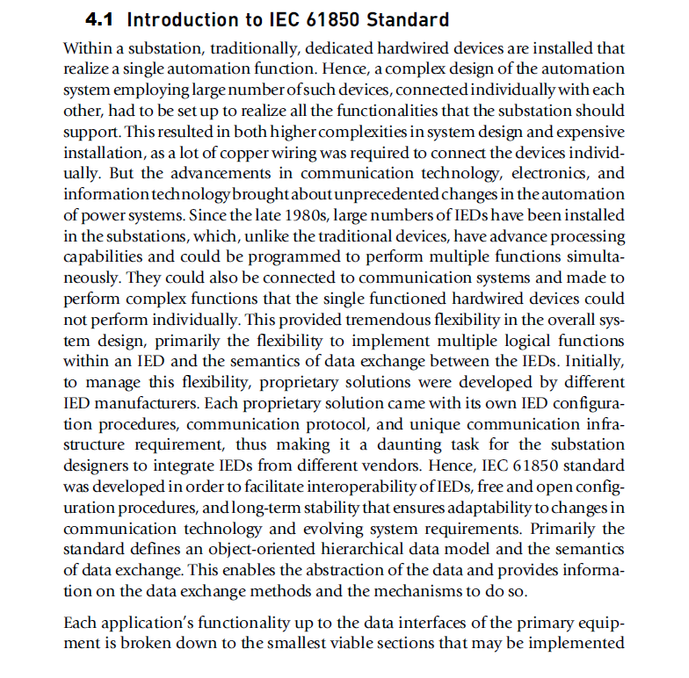
CHAPTER 4 :IEC 61850 Standard.

Slide 25
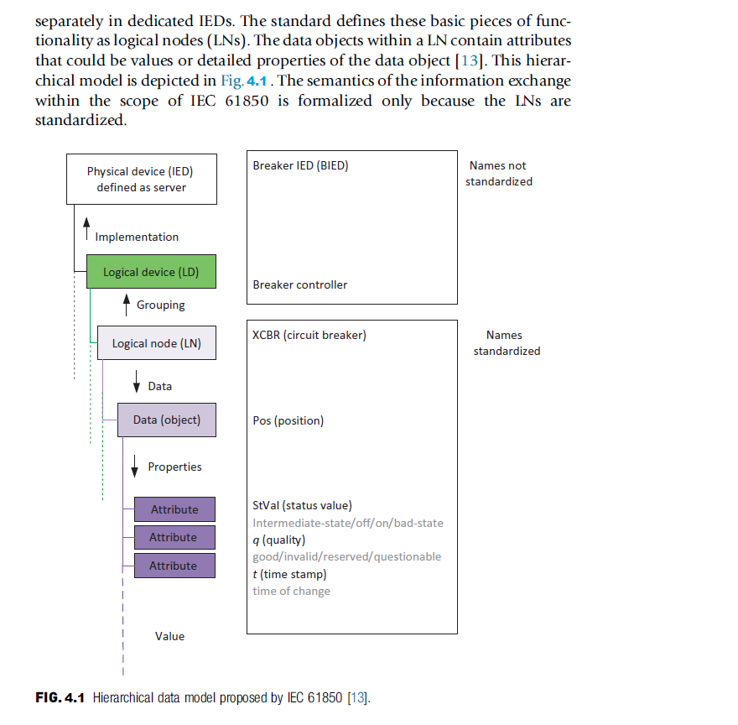

Slide 26
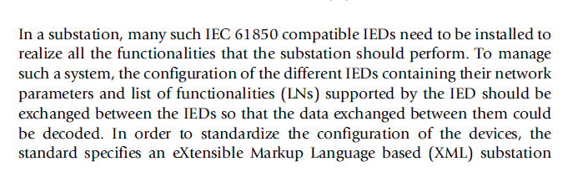
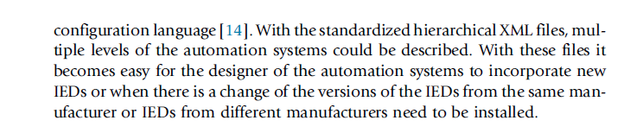

Slide 27
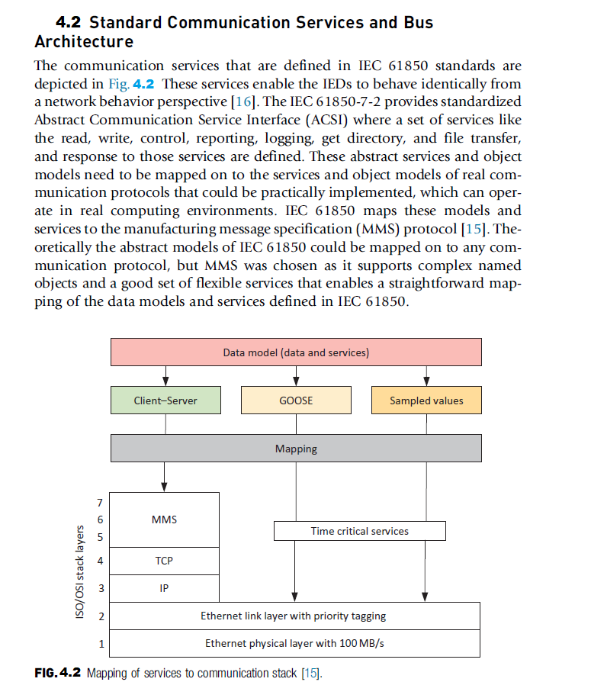

Slide 28
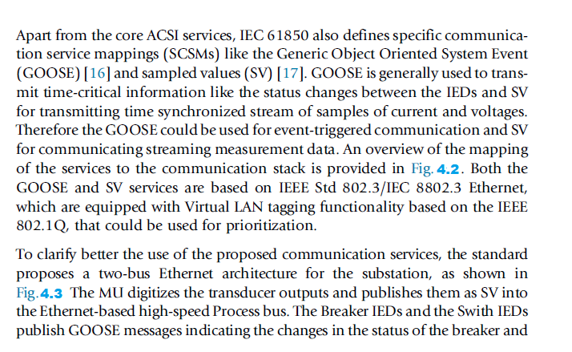

Slide 29
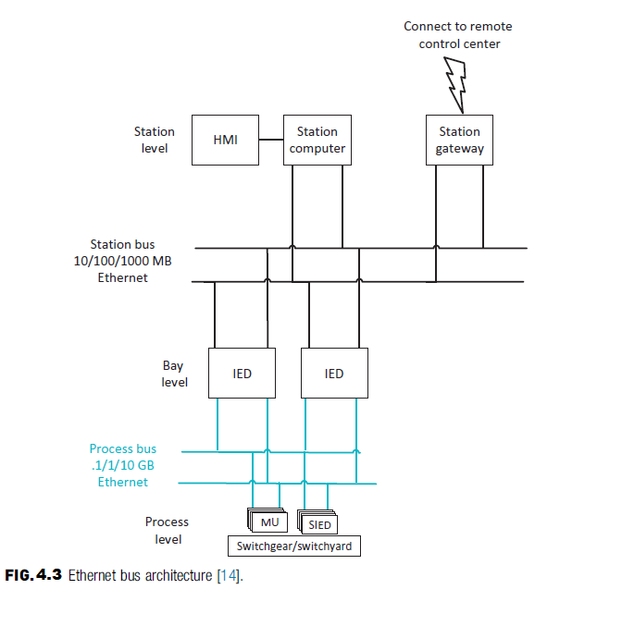

Slide 30
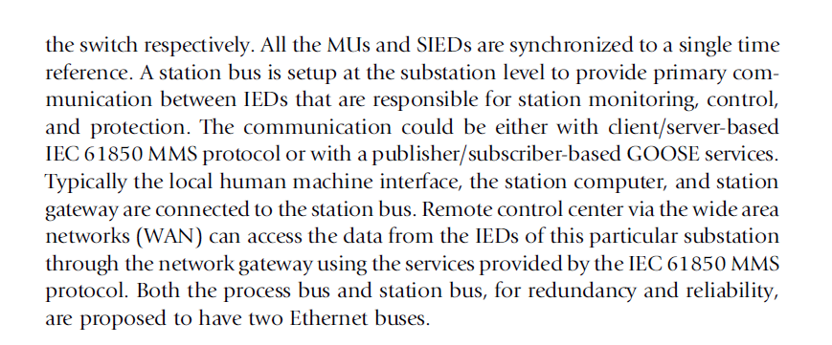

Slide 31
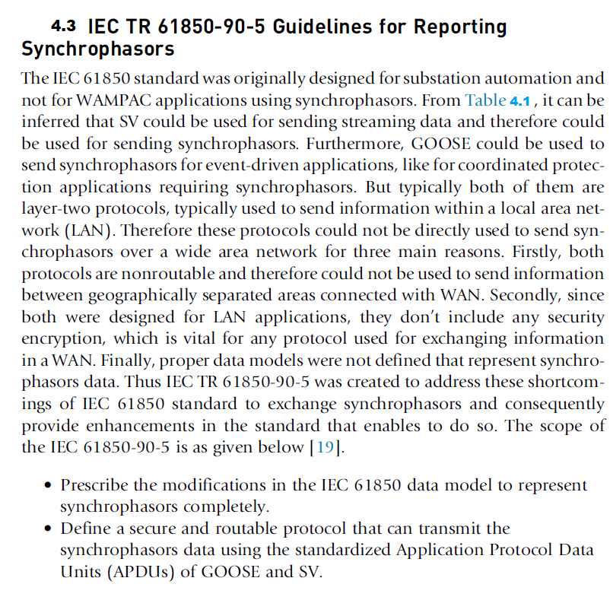

Slide 32
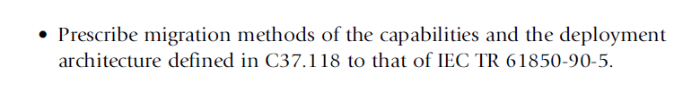
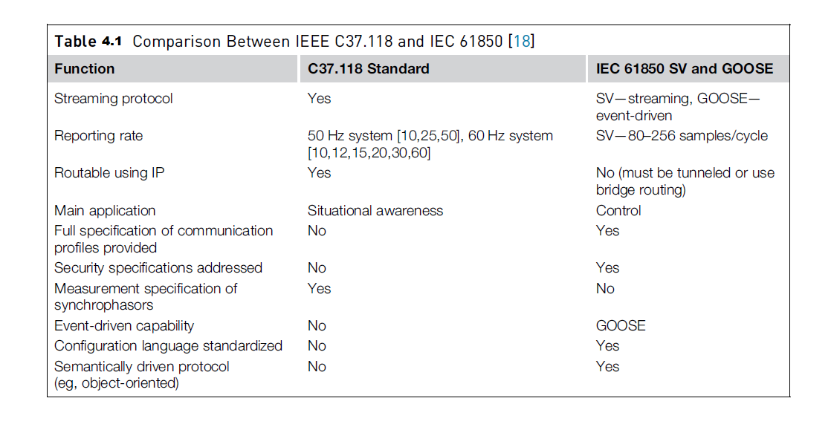

Slide 33
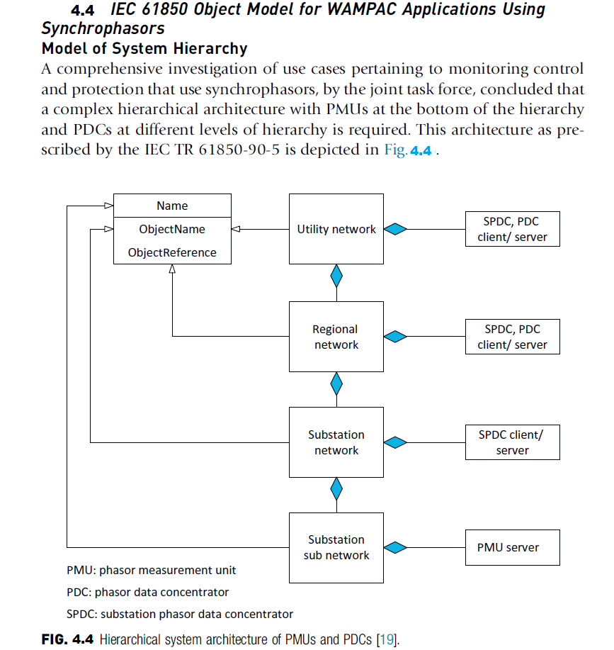

Slide 34
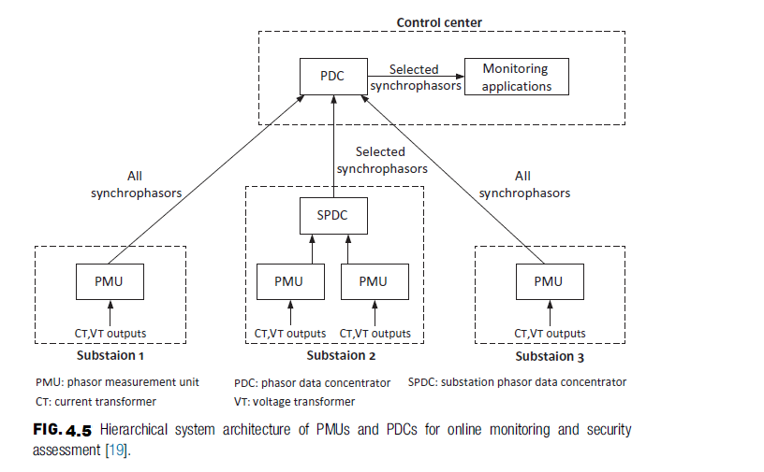

Slide 35
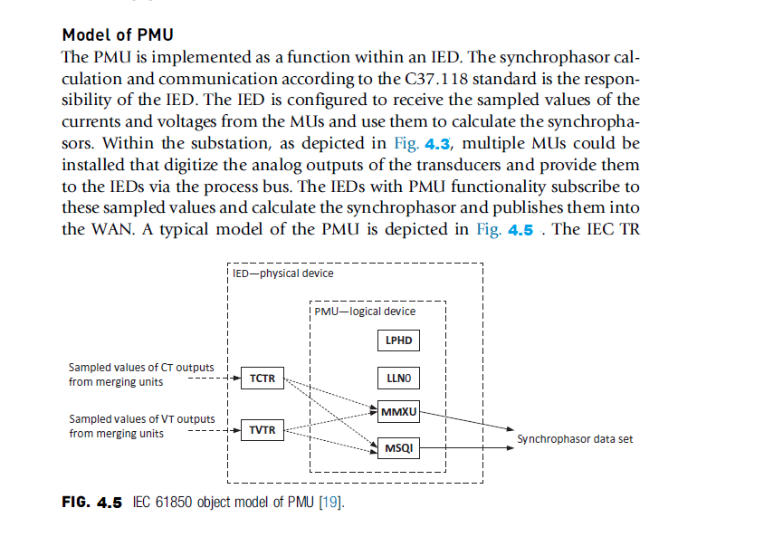

Slide 36
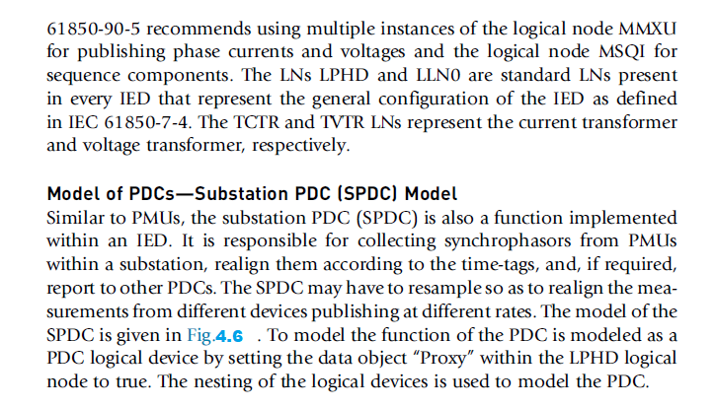

Slide 37
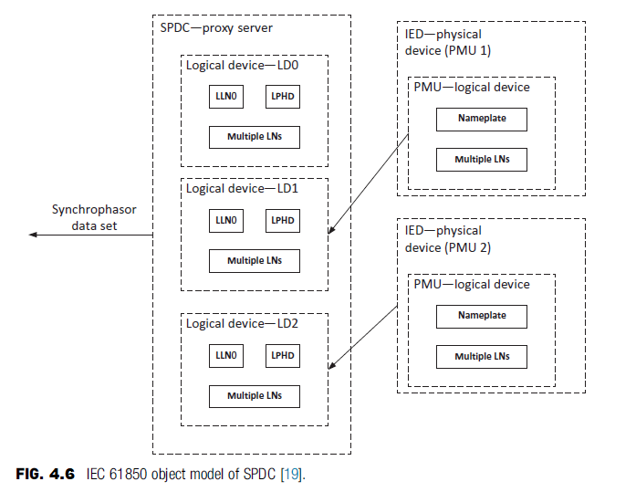

Slide 38
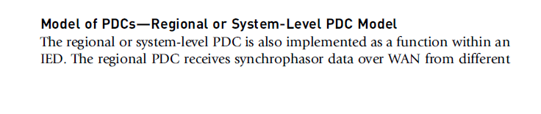

Slide 40
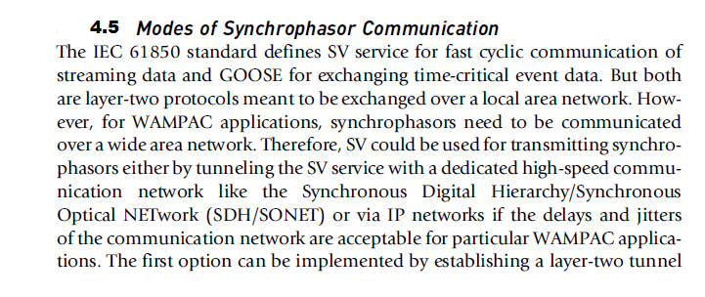
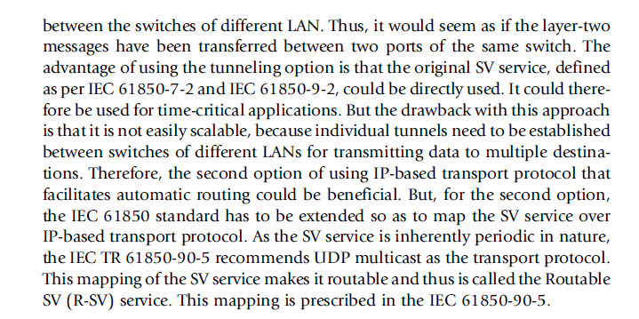

Slide 41
Wide Area Protection :
INTRODUCTION :
The growth of electrical power systems is a challenge for Energy Management Systems to ensure a safe and reliable operation, This situation originates the need for tools that help to visualize and control electrical system variables using high speed communications channels and accurate data, allowing the grid operator to estimate the state of the system in real time through mathematical calculations,, We can define Wide Area Systems as a Summation of small or large areas that are not connected directly to each other and are separated from each other and it have a large distance between each other and through Wide Area Protection system Real-Time data can be collected from all these Areas and then it can be shared to each other and then monitored at one place and then controlling the whole Area from the Control Station.

Slide 42
There are many defects in the traditional Protection schemes so we used the Wide Area Protection as a Back-up Protection and these reasons are as follow :
1- Modern power systems are in the process of continuous development which has led to complex interconnected Networks, Financial pressure on the electricity market and on grid operators forces them to maximize the utilization of high voltage equipment, which very often lead their operation closer to the limits of the system, This approach of ensuring economic operation is possible provided the system is equipped with a well-designed and coordinated protection and control strategy to deal with wide spread disturbances in the system.
2-Traditional power system protection and control measures are based on local measurements, However, it is quite difficult to maintain the stability and security of the system on the whole, if only local measurements are employed in the protection and control schemes,, One promising way is to provide a system wide protection and control, complementary to the conventional local protection strategies, While it is not possible to predict or prevent all contingencies that may lead to power system collapse, a wide-area monitoring and control system that provides a reliable security prediction and optimized coordinated action is able to mitigate or prevent large area disturbances, The main tasks, which can be accomplished through wide-area based monitoring and control.

Slide 43
Wide Area Protection as a Back-up Protection :
3- Conventional Problems happened because of many things like false tripping or not tripping at all and all of these problems can cause at some times serious problems that may lead to disasters and these problems should be controlled and isolated once it happened and for example,, The distance relays which are widely used in the protection nowadays and it involve the determination of impedance achieve operating times of the order of a period of the power system frequency, A distance relay is designed to only operate for faults occurring between the relay location and the selected reach point, and remains stable for all faults outside this region or zone, Consider that a fault with a resistance happened to this zone of the Distance Relay then what will happen?
The resistance of the fault arc takes the fault impedance outside the relay’s tripping characteristic and, hence, it does not detect this condition. Alternatively, it is only picked up either by zone 2 or zone 3 in which case tripping will be unacceptably delayed, The distance relays are based on standalone decision, while each relay operates independently according to three different zone of operation.
Wide-area protection and its development : WAPS are focused on two fields: First is security, stability and control, Second is the relay protection, In the security and stability control field,, WAPS is mainly used to prevent long-term voltage collapse It is established on basis of the supervisory control and data acquisition (SCADA) system, with centralized decision-making structures, non-real-time data collection, and slow data refresh frequency, The communication system does not require fast, real-time data exchange,, Compared to the traditional strategies of stability control, WAPS involves a wider geographical scope and requires more complex calculations in the processes of getting information, forming control strategies, and carrying out control measures.

Slide 44
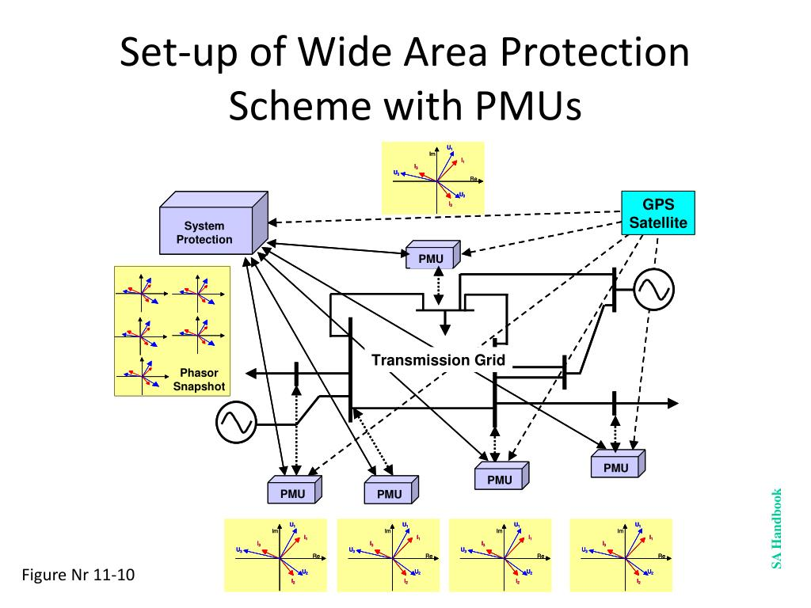
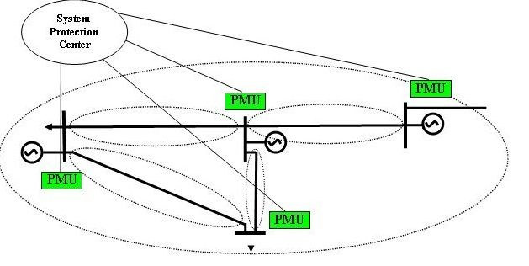
In the relay protection field, It uses globe positioning system (GPS) signals for precise time synchronization with using PMU devices and then collect all these data from these Devices and send it to PDC, and a dedicated fiber channel for multi-point current information transmission, And it can be easily make a backup protection for the system and avoid traditional problems.
The communication of data among them is carried via optic-fiber networks, The relay decision is based on collected and shared data through communication network. The suggested technique satisfies high degree of reliability and stability while it is based on shared decision rather than standalone decision. The suggested technique can see all the power system area and can deal with the transmission lines as unit protection.

Slide 45
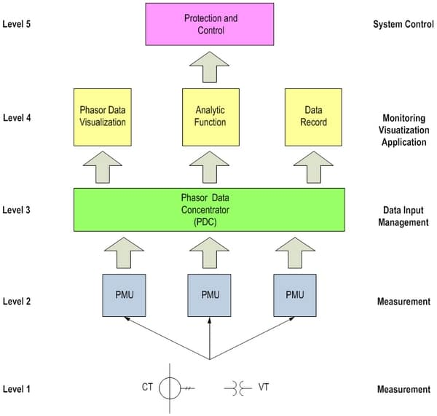
While Traditional protection relays and devices operate through slow times, and these actions are certainly uncoordinated, Coordinated actions will be taken through SCADA/EMS systems by operators, however in prolonged times, which might make the situations too late to rescue,, Wide Area Protection (WAP) systems provide a very promising future in the face of wide-area disturbances and blackouts,, Phasor measurement technologies now allow accurate comparison of measurements over widely separated locations as well as potential real-time measurement based control actions. Hence WAP systems could be employed to fulfill the two main objectives of increasing transmission capability as well as increasing system reliability, by performing a real-time, look ahead analysis giving some recommendation of possible updated control strategies and actions, especially in the events of contingencies. The WAP system shall know what actions to take based on the present system condition in the case that a certain contingency occurring, or would take an action saving the system progressing into an unstable state.
The Wide Area protection and control are exist at bay, substation and regional levels, Covering both transmission and distribution networks, the system is supported by the proposed high speed synchronized communication network and the real-time protection and control information platform, The system section techniques and the latest developments in control system, offers not only fast protection, but also complete control of entire power network.

Slide 46
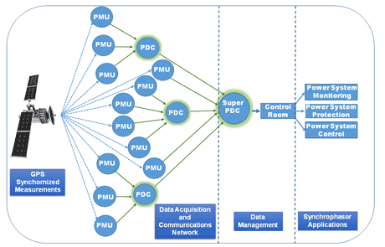
Wide Area Monitoring is the first step of Wide Area Protection:
The Wide Area Monitoring System (WAMS) consists of geographically dispersed Phasor Measurement Units (PMUs) delivering Synchrophasors, i.e., time-tagged data samples of a power system’s sinusoidal voltage or current using a standard time signal as the reference, to Phasor Data Concentrators (PDCs), These (PDCs) perform the desired signal handling and assembly of synchronized Phasor measurements into snapshots. They may also facilitate long term storage in high-resolution historical archives. The data in each PMU are time Synchronized to Universal Coordinated Time (UTC),, (WAM) became one of the most recent technologies that are popular for upgrading the traditional electric grid, This upgrade has become a necessity to modernize the electricity delivery system following the occurrence of major blackouts in power systems around the world
Wide Area Monitoring Systems collect the information from the power system, analyze the data and interpret the result, giving “warnings” to the system operator or initiating “defense schemes” in order to prevent stability problems,, WAMS consist of the 3 major components: Phasor Measurement Unit (PMU), Phasor Data Concentrator (PDC) and communication channel.

Slide 47
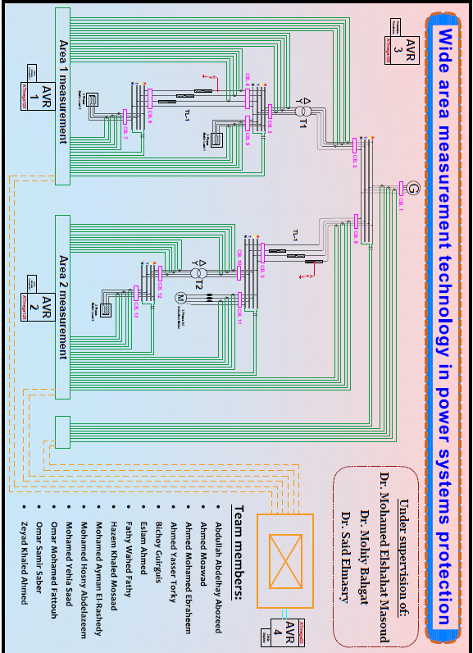
Our Project scheme

Slide 48
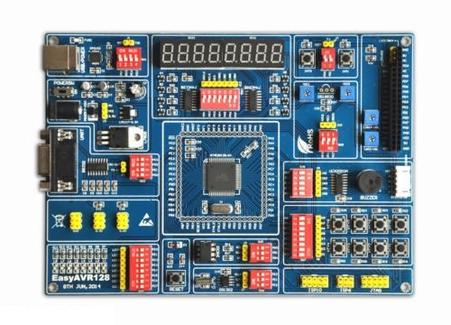
As show in our scheme
We use at mega 128 micro controllers which consist of :
2 micro-controller as pmu
1 micro-controller as pdc
1 micro-controller as protection function
1 GPS
1HMI Smart
his IED’s programmed to satisfy Their desired functions .
in our project
AVR (1) and AVR(2) act as a PMU which read The data From system and synchronized it From Samples come from GPS Then Send it to AVR(4) which connected to Smart screen That’s The Real time data of system and AVR(4) act as protection function

Slide 49
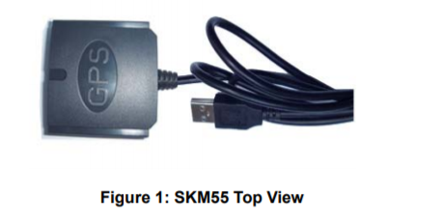
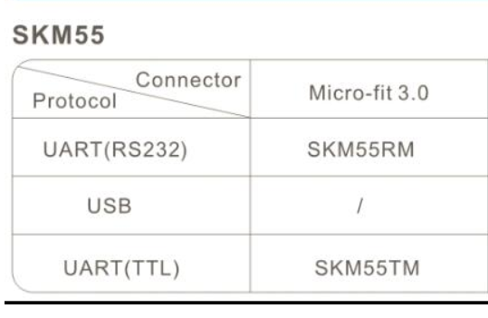
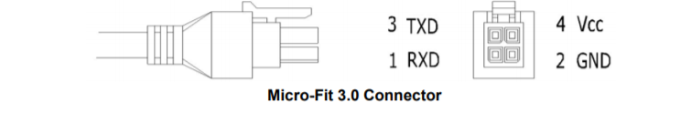
GPS module”SKM55RM”

Slide 50
Hardware Interfaces Configuration
UART Ports:
The SKM55 series supports one full duplex serial channels UART.
The serial connections are at 2.85V LVTTL logic levels, if need different voltage levels, use appropriate level shifters. the data format is however fixed: X, N, 8, 1, i.e. X baud rate, no parity, eight data bits and one stop bit, no other data formats are supported, LSB is sent first. The modules default baud
rate is set up 9600bps.
RS232 Ports:
The SKM55 series uses single-chip RS232 to UART bridge, It is 3V powered EIA/TIA-232 and V.28/V.24 communication interfaces with low power requirements.

Slide 51
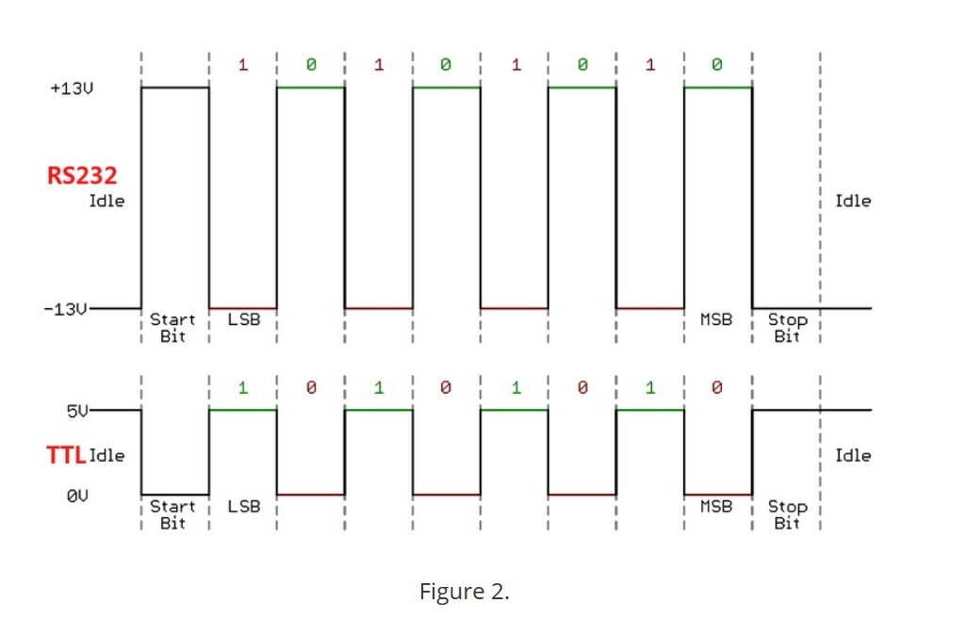
Hardware Interfaces Configuration

Slide 52
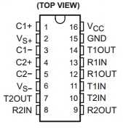
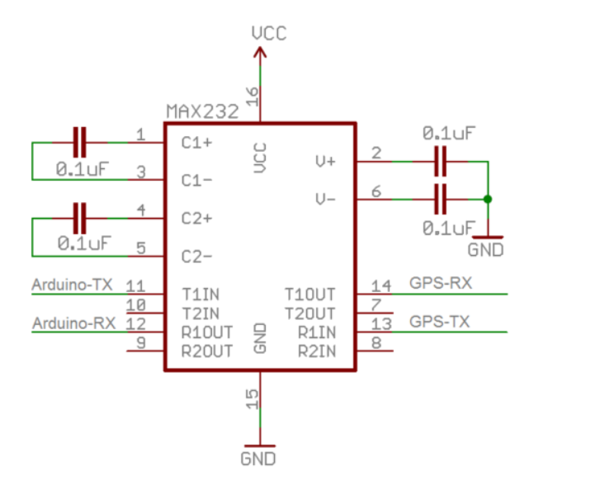
MAX232 connection
*Using max232 IC as logic shifter.
Using Atmega 128 instead of Arduino in our case.

Slide 53
Software Protocol
NMEA 0183 Protocol :
The NMEA protocol is an ASCII-based protocol,
records start with a “$ “and with carriage return/line feed.
GPS specific messages all start with $GPxxx where xxx
is a three-letter identifier of the message data that
follows.
NMEA messages have a checksum, which allows detection of corrupted data transfers.
NMEA Record Description
GGA Global positioning system fixed data.
GLL Geographic position-latitude/longitude.
GSA GNSS DOP and active satellites.
GSV GNSS satellites in view .
RMC Recommended minimum specific
GNSS data .
VTG Course over ground and ground speed.
ZDA Date and Time
GGA-Global Positioning System Fixed Data :
“$GPGGA,021514.000,2232.1799,N,11401.1823,E,1,6,1.25,84.0,M,-2.2,M,,*74 “.
This sentence contains the position, time and quality of the navigation fix.
“Nema protocol,UTC,Latitude,N,Longitude,E,PF,......”

Slide 54
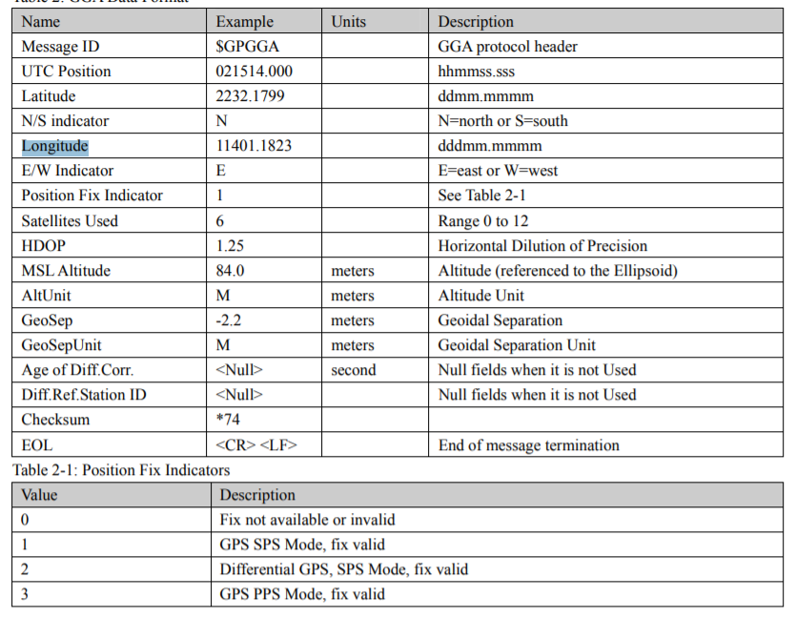

Slide 55
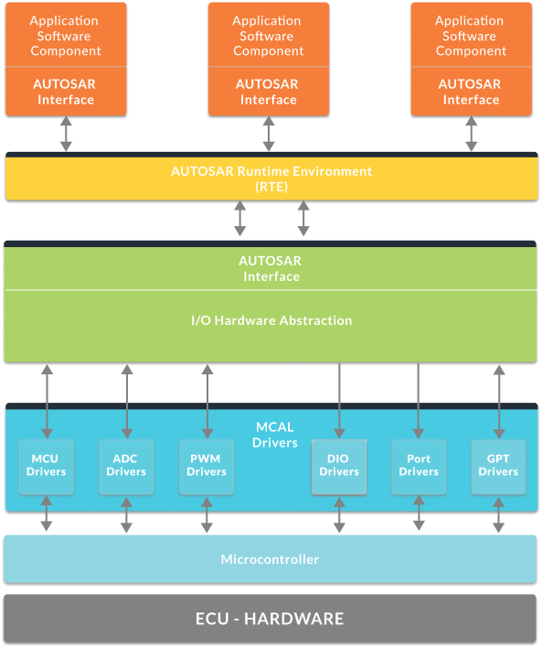
Software layers

Slide 56
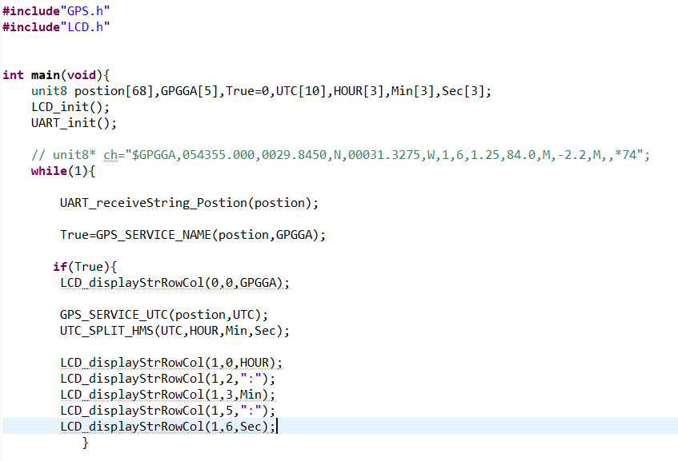
Software code using embedded C

Slide 57
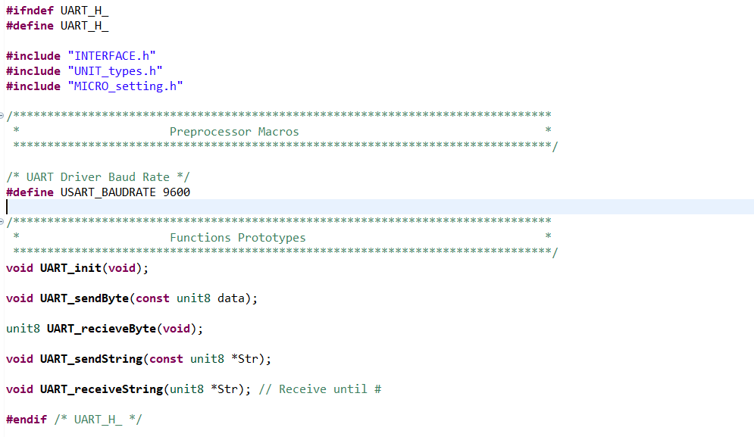
Software code using embedded C

Slide 58

Software code using embedded C

Slide 59

Software code using embedded C

Slide 60

Software code using embedded C

Slide 61

Software code using embedded C

Slide 62

Software code using embedded C

Slide 63


Slide 64
Wirless Transmitter - Reciever RF 433MHZ
1.1 Defination
In generally, the wireless systems designer has two overriding constraints: it must operate over a certain distance and transfer a certain amount of information within a data rate. The RF modules are very small in dimension and have a wide operating voltage range i.e. 3V to 12 V.
Basically the RF modules are 433 MHz RF transmitter and receiver modules. The transmitter draws no power when transmitting logic zero while fully suppressing the carrier frequency thus consume significantly low power in battery operation. When logic one is sent carrier is fully on to about 4.5mA with a 3volts power supply. The data is sent serially from the transmitter which is received by the tuned receiver. Transmitter and the receiver are duly interfaced to two microcontrollers for data transfer.

Slide 65

1.2 Introduction
This kit is used for one way wireless communication at a frequency of 433MHz and includes a
transmitter module and a receiver module. The twig configuration of this kit allows for around 40
meters of transmitting distance indoors, or around 100 meters outside.
The 433Hz wireless module is one of the cheap and easy to use modules for all wireless projects. These modules can be used only in pairs and only simplex communication is possible. Meaning the transmitter can only transmit information and the receiver can only receive it, so you can only send data from point A to B and not from B to A

Slide 66

2. Configurition of module
Pin Configuration;
No: | Pin Name | Description
1 | Vcc | Power supply (3V to 12V)
2 | Data | Data received can be obtained from this pin
3 | Data | It serves the same purpose (any one can be used)
4 | Gnd | Connected to the ground of the circuit

Slide 67



Slide 68
3.1 433 MHz Module Specifications
(1) Wireless (RF) Simplex Transmitter and Receiver
(2) Receiver Operating Voltage: 3V to 12V
(3) Receiver Operating current: 5.5mA
(4) Operating frequency: 433 MHz
(5) Transmission Distance: 3 meters (without antenna) to 100 meters (maximum)
(6) Modulating Technique: ASK (Amplitude shift keying
(7) Data Transmission speed: 10Kbps
(8) Circuit type: Saw resonator
(9) Low cost and small package

Slide 69
3.2 Specification
3.2.1 Transmitter Module
Item | Min | Typical | Max | Unit
Working Voltage | 3.0 | 5.0 | 12.0 | VDC
Current | 3 | I | ]0 | mA
Work Mode |  | ASK |  | I
Transmit PoweifMax) |  | 15 |  | mW
Working Distance | 40 | i | 100 | m
3.2.2 Reciever Module
Item | Typical | Unit
Working Voltage | 5 | VDC
Quiescent Current | 5 | mA
Receiver Sensitivity | ■105 | dBm
Operating frequency | 433,92 | MHz

Slide 70

4.1 Features
4.1.1 GROVE compatible interface
The Grove System is a physical standardization of various electrical interfaces including but not limited to I2C, SPI, UART, GPIO, and analog connections. The Grove base shield is an Arduino 1.0 shield used to connect various peripherals to an Arduino-compatible mainboard.
4.1.2 Uses ASK (Amplitude Shift Keying) Modulation
is a form of amplitude modulation that represents digital data as variations in the amplitude of a carrier wave. In an ASK system, the binary symbol 1 is represented by transmitting a fixed-amplitude carrier wave and fixed frequency for a bit duration of T seconds. If the signal value is 1 then the carrier signal will be transmitted; otherwise, a signal value of 0 will be transmitted.
ASK system can be divided into three blocks. The first one represents the transmitter, the second one is a linear model of the effects of the channel, the third one shows the structure of the receiver. The following notation is used:

Slide 71
ht(f) is the carrier signal for the transmission hc(f) is the impulse response of the channel n(t) is the noise introduced by the channel hr(f) is the filter at the receiver
L is the number of levels that are used for transmission Ts is the time between the generation of two symbols
4.1.3 One way communication
In one-way communication, information is transferred in one direction only, from the sender to the receiver. There isn’t any opportunity for the receiver to give feedback to the sender.
4.2 Application Ideas
Home automation
Transmit Serial data for short distance Car security system Wireless logging Short distance communication Wide Area System

Slide 72
5. Usage
The transmitter and receiver modules both rely on a single wire for communication. Though using
the UART supplied by the Arduino platform can work, it is recommended, instead, to use the
VirtualWire library which uses Amplitude Shift Keying for modulation which provides better
Communication.
Both the transmitter and receiver modules require three wires: Vcc, Ground, and signal. Pin 2 of
both parts of the kit are not connected.
_ Connect the Transmitter module to Digital I/O 2 of the Grove_-_Base_Shield on the Microcontroller .
being used for transmission.
Error creating thumbnail: Invalid thumbnail parameters
_ Connect the Receiver module to Digital I/O 2 of the Grove_-_Base_Shield on the receiving
Microcontroller .
Error creating thumbnail: Invalid thumbnail parameters

Slide 73

Upload the code below for transmitter module :

Slide 74
Upload the code below for receiver module :
//Grove - 315(433) RF link kit Demo vl.0 //by :http://www. seeedstudio.com/
//connect the receive module to D2 to use ..
^include <VirtualWire.h>
int RF_RX_PIN = 2;
void setup ()
{
Serial, begin(9600);
Serial, println('setup');
vw_set_rx_pin(RF_RX_PIN); // Setup receive pin. vw_setup(2000); // Transmission speed in bits per second. vw_rx_start(): // Start the PLL receiver.
}
void loopO
{
uint8_t buf[Vf_MAX_MESSAGE_L£N]:
uint8_t buflen = VW_MAX_MESSAGE_LEN:
if(vw_get_message(buf, ftbuflen)) // non-blocking I/O
int i;
// Message with a good checksum received, dump HEX Serial.print('Got: '); for(i = 0: i < buflen; ++i)
{
Serial, print (buf [i], HEX):
Serial, print (' '):
//Serial, print(buf[i]);
}
Serial. println("):
}
Open the serial monitor of receiver module to see the result.

Slide 75

In our graduation project, we have used many tools to complete it correctly, and are like the following :

Slide 76

1- 2 transformers 1.5 MVA :
We used two transformers that convert the voltage from 380 to 220 volts by a delta connection to a star connection , We used the transformers in this MVA to cope with the loads and transmission lines manufactured for this project.
The project was developed in the following manner:
The transformer is placed immediately after the source and the other is placed after the transmission line .

Slide 77

2- 2 Transmission lines :
- For the first transmission line the length of the wire is 115 meters and the number of rolls is 332 Ips, while it consists of four layers, the DC resistance is equal to 1.7 ohm , and the impedance equals 2.5 ohm , And thus L equals 0.0079577 Henry.
- For the second transmission line the length of the wire is 90 meters and the number of rolls of the transformer is 285 rolls, while it consists of three layers, DC resistance equals 2.3 ohm, and impedence equals 3.749 ohm , And thus L equals 0.01193 Henry.

Slide 78

3- 1 three phase induction motor :
The name of the motor is :
It is run on 380 volts, rated current has 2 amperes, its capacity is 1 hp
4- 3 static loads :
The three static loads have the same power 610 watt.
Each phase of static load was represented by three lamps with 247-ohm , and to achieve the required resistance equal to 80 ohms , each phase was connected to three parallel lamps.
All of the above has been done in each phase of three phase of three static loads.

Slide 79


5- 5 three phase contactors 380 volt and 9-ampere were used, and 7 three phase contactors 220 volt and 9 ampere were used .
We used a kit relay to contact with the contactor and connect the kit with micro controller (ATMEGA 128) .

Slide 80


Finally , we used a three circuit breakers single phase to each phase before the slag bus 220 volt , 6 ampere .
6- We used 2 voltage transformers convert 400 volt to 5 volt and used 3 voltage transformers convert 250 volt to 5 volt each one installed of each BUS-BAR .
7- We used 36 single phase current sensors 30 ampere in our project to sense the current and connected with the part of communication .

Slide 81


8- We used 20 Aluminum BUS-BARS on our Graduation project and we used it as collection point .

Slide 82
References :
[1] Venkatasubramanian V, Li Y. Analysis of 1996 Western American electric blackouts. In: IREP
conference, Cortina, Italy; 2004.
[2] NERC. Technical analysis of the August 14, 2003, blackout, http://www.nerc.com/docs/docs/
blackout/NERC_Final_Blackout_Report_07_13_04.pdf; 2004 [accessed 15.03.16].
[3] Berizzi A. The Italian 2003 blackout. IEEE PES general meeting. Denver, CO: Publ IEEE; 2004.
[4] Larsson S, Ek E. The black-out in southern Sweden and eastern Denmark, September 23, 2003.
IEEE PES general meeting. Denver, CO: Publ IEEE; 2004.
[5] NASPI. Synchrophasor technology factsheet. https://www.naspi.org/File.aspx?fileID¼1326;
2014 [accessed 15.03.16].
[6] Scottish Power Transmission Ltd. Electricity network innovation competition submission—
VISOR. https://www.ofgem.gov.uk/sites/default/files/docs/2013/11/nic_submission_for_
sp_transmission_-_visor_0.pdf; 2013 [accessed 15.03.16].
[7] Wilson D. Discrete control for transient stability and oscillations: applications and case
studies. In: IEEE PES general meeting, Vancouver, BC, Canada; 2013.
[8] Arango O. Low frequency oscillations in the Colombian power system—identification and
remedial actions, In: Cigre session, Paris, France; 2010.
[9] Adams J. ERCOT experience with sub-synchronous control interaction and proposed remediation,
In: IEEE T&D Conference and Exposition, Orlando, FL; 2012.
[10] Messina A. Inter-area oscillations in power systems. Berlin, Germany: Springer; 2009.
[11] Sanchez-Gasca J. (Chair) Identification of electromechanical modes in power systems. PES
Technical Report, PES-TR15. IEEE; June 2012. ISBN 978-1-4799-1000-7.

Slide 83
[12] Cigre Task Force 38.01.07. Analysis and control of power system oscillations. Paris, France:
Cigre; 1996.
[13] Liu G. Oscillation monitoring system based on wide area synchrophasors in power systems.
In: IREP, Charleston, SC; 2007.
[14] Wilson D. Identifying potential interaction between BWR plant dynamics and power system
electromechanical oscillations. In: IEEE PSCE, New York; 2006.
[15] Al-Ashwal N. Identifying sources of oscillations using wide area measurements. In: Cigre grid
of the future, Houston, TX; 2014.
[16] Australian Energy Market Commission. Australian National Electricity Rules version 76.
http://www.aemc.gov.au/Energy-Rules/National-electricity-rules/Current-Rules; 2015[accessed
15.03.16].
[17] IEEE PES. IEEE tutorial course: power system stabilization via excitation control. http://sites.
ieee.org/pes-resource-center/files/2013/10/09TP250E.pdf; 2007 [accessed 15.03.16].
[18] King R. HVDC stability control using wide area measurements for optimising transmission
boundary transfer. In: IET ACDC, Birmingham; 2015.
[19] Parashar M. Continuum modeling of electromechanical dynamics in large-scale power systems.
IEEE Trans Circuits Syst 2004;1:1848–58.
[20] UCTE. Final report: system disturbance on 4 November 2006. https://www.entsoe.eu/
fileadmin/user_upload/_library/publications/ce/otherreports/Final-Report-20070130.pdf;
2007 [accessed 15.03.16].
[21] Best R. Techniques for multiple-set synchronous islanding control. IEEE Trans Smart Grid
2011;2(1):60–7.
[22] Wang D. Defining constraint thresholds by angles in a stability constrained corridor with high
wind. In: IEEE PES T&D Conference and Exposition, Chicago, IL; 2014.
[23] SP Transmission. SP transmission NIA annual report. http://www.smarternetworks.org/Files/
NIA_&_NIC_150729160157.pdf; 2015 [accessed 15.03.16].
[24] Wang D. Quantifying benefit of angle constraint active management on 33 kV distribution
network. In: CIRED, Lyon, France; 2015.

